Slide 1
Ridge and Lasso regression

Slide 2
Regression Coefficients indicates the impact of a unit change in the known variable (x) on the estimated variable (y).
larger the absolute value of the coefficient, the more power it has to change the predicted response, resulting in a higher variance
Regularization is a method for “constraining” or “regularizing” the size of the coefficients, thus “shrinking” them towards zero.
It reduces model variance and thus minimizes overfitting.

Slide 3
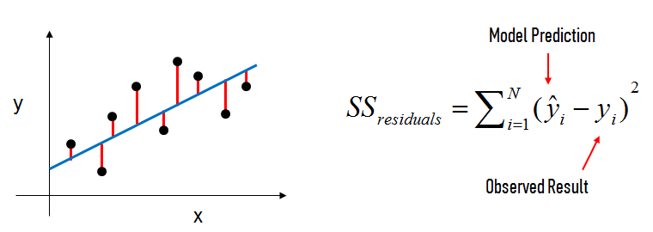
For a normal linear regression model, we estimate the coefficients using the least squares criterion, which minimizes the residual sum of squares (RSS):

Slide 4
How does regularization work?
For a regularized linear regression model, we minimize the sum of RSS and a “penalty term” that penalizes coefficient size.
Scaling should be performed before otherwise, features would be penalized simply because of their scale.

Slide 5
Lasso regression
Least Absolute Shrinkage and Selection Operator
L1 regularization

Slide 6
Shrinks coefficients all the way to zero, thus making them zero and removing them from the model
The lasso procedure encourages simple, sparse models (i.e. models with fewer parameters
L1 regularization, which adds a penalty equal to the absolute value of the magnitude of coefficients.
This type of regularization can result in sparse models with few coefficients; Some coefficients can become zero and eliminated from the model.
Larger penalties result in coefficient values closer to zero.
If group of predictors are highly correlated, lasso picks only one of them and shrinks the others to zero
Objective = RSS + λ * (sum of absolute value of coefficients)

Slide 7
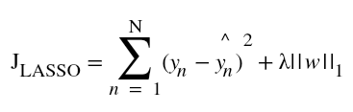
RSS refers to ‘Residual Sum of Squares’ which is nothing but the sum of square of errors between the predicted and actual values in the training data set., also known as the sum of squared residuals–essentially determines how well a regression model explains or represents the data in the model.

Slide 8
A tuning parameter, λ controls the strength of the L1 penalty.
λ is basically the amount of shrinkage
When
λ = 0, no parameters are eliminated.
The estimate is equal to the one found with linear regression.
As λ increases, more and more coefficients are set to zero and eliminated
Theoretically, when λ = ∞, all coefficients are eliminated
As λ increases, bias increases.
As λ decreases, variance increases.

Slide 9
Ridge Regression - L2 regularization

Slide 10
Ridge regression shrinks the value of coefficients but doesn’t reaches zero
It adds a factor of sum of squares of coefficients.
Higher the lambda value, more restriction on the coefficients
Low lambda, more generalization thus coefficients are barely restricted
Ridge regression solves the multicollinearity problem through shrinkage parameter λ (lambda)
The magnitude of λ will decide the weightage given to features

Slide 11
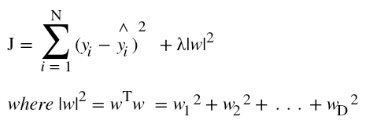
|w|² equals the square of the magnitude of coefficients
Range of Lambda is between 0 and ∞

Slide 12
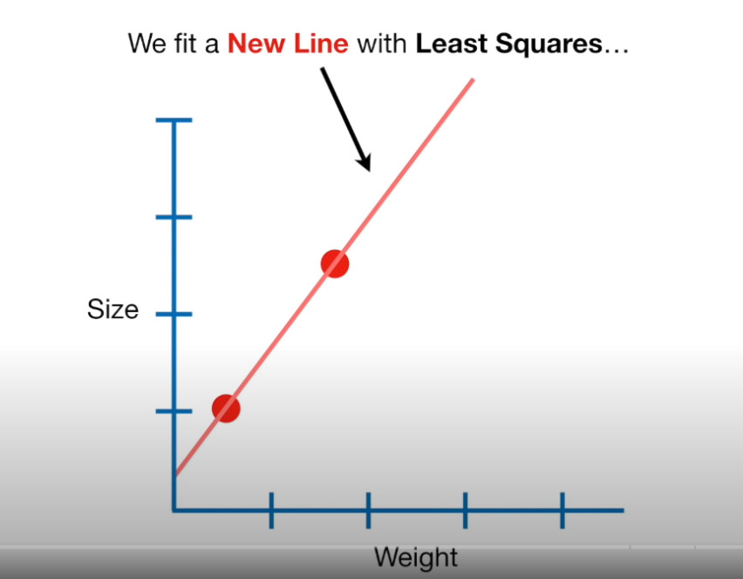
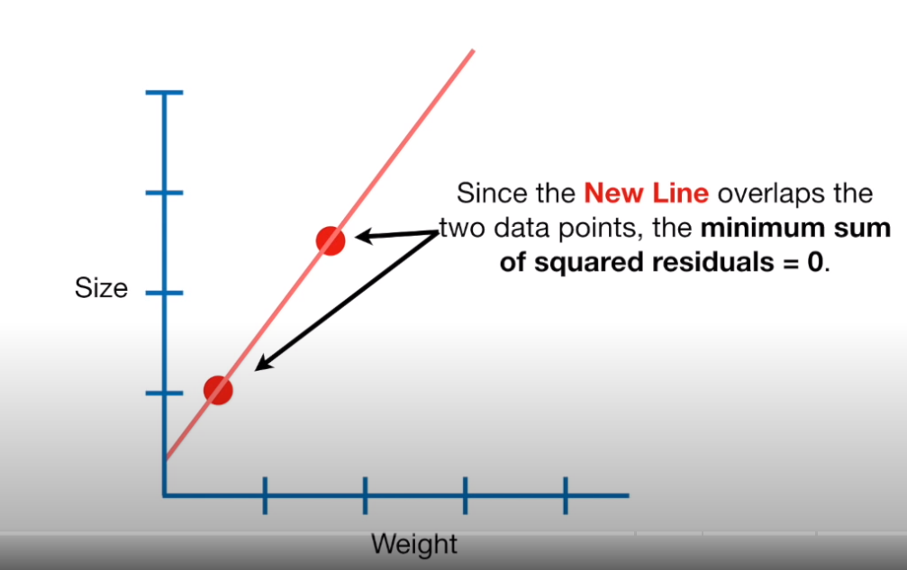

Slide 13
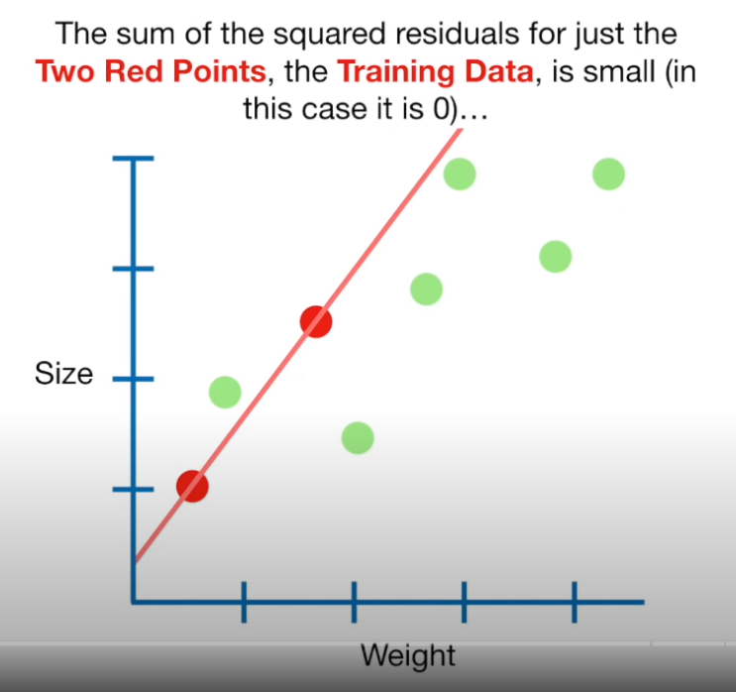
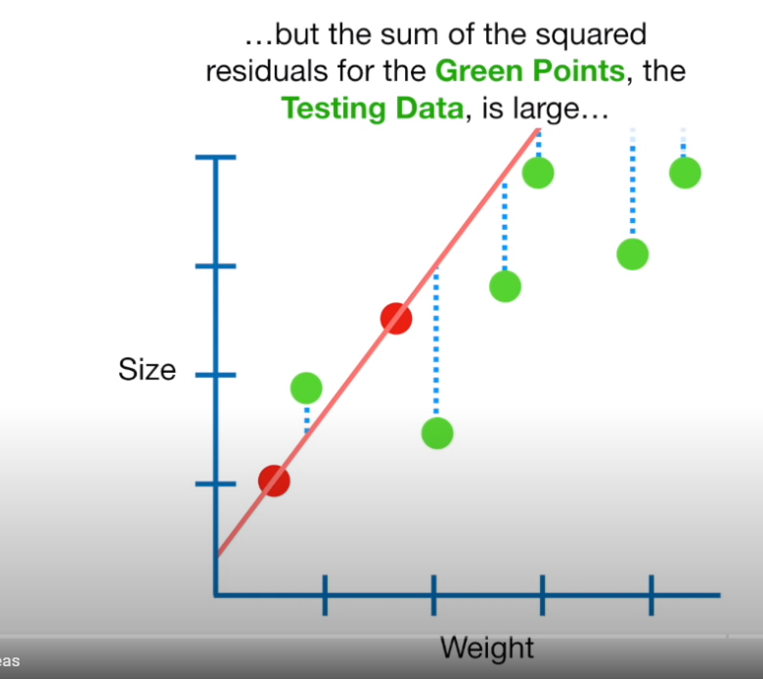

Slide 14
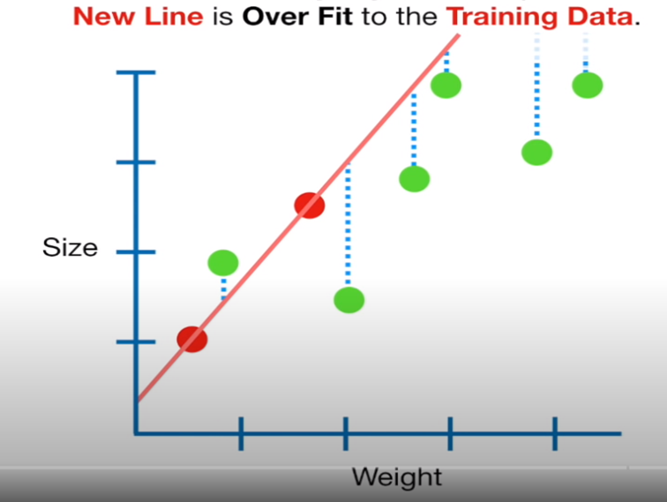

Slide 15
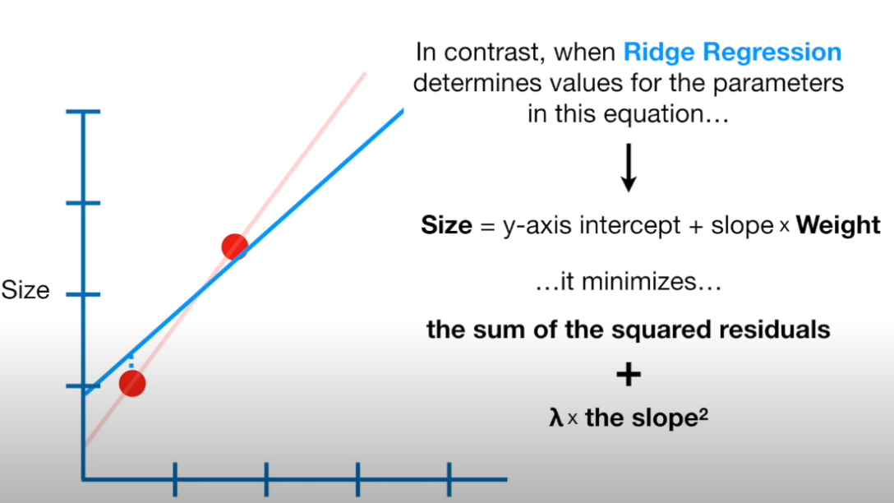

Slide 16
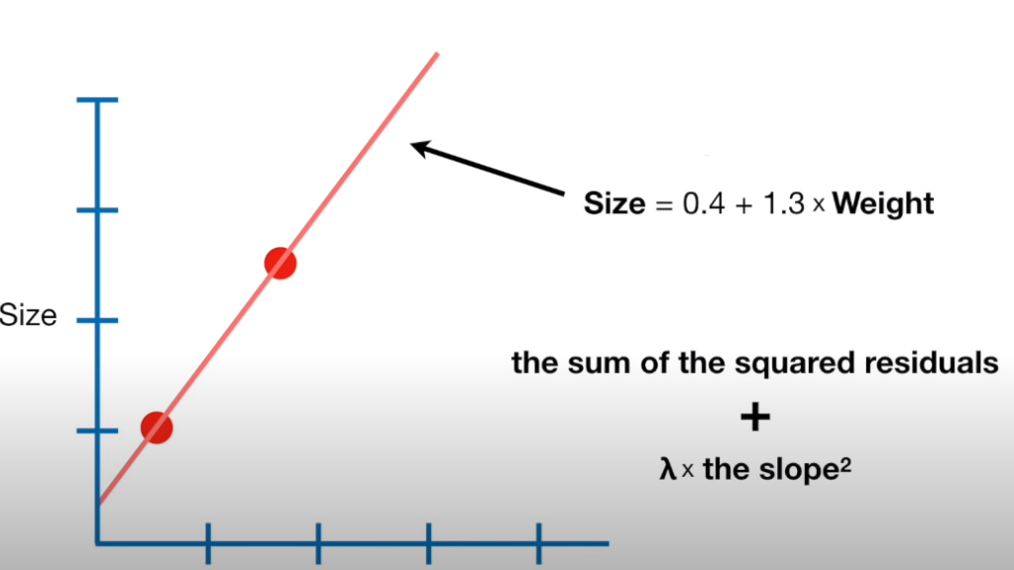
Y = mx + b

Slide 17
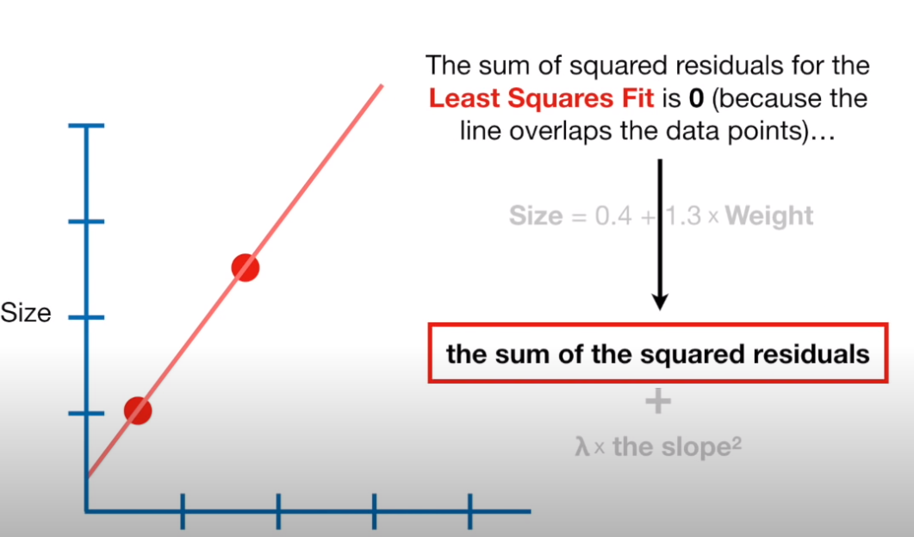

Slide 18
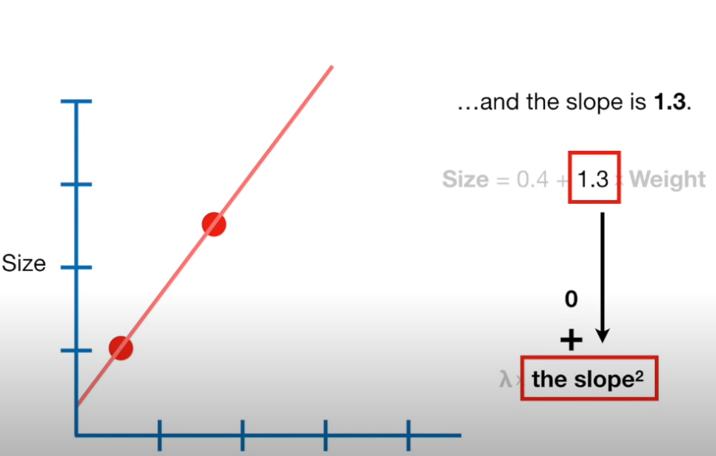

Slide 19
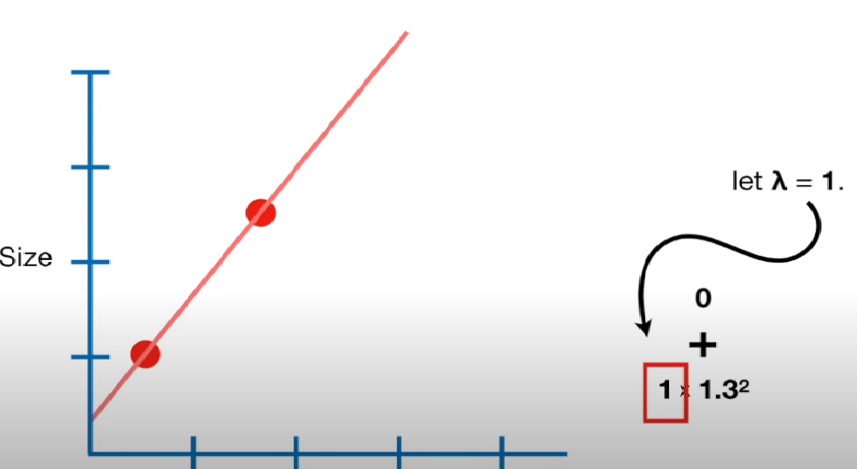

Slide 20
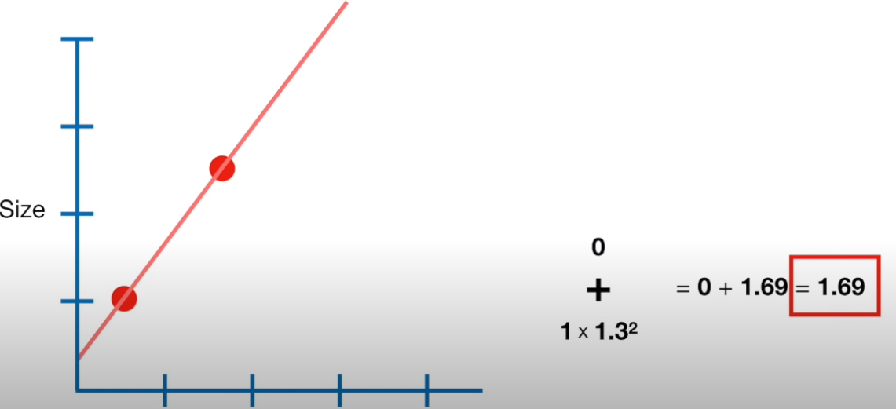
For Least Squares Line, the RSS and Ridge Regression penalty comes out to be 1.69

Slide 21
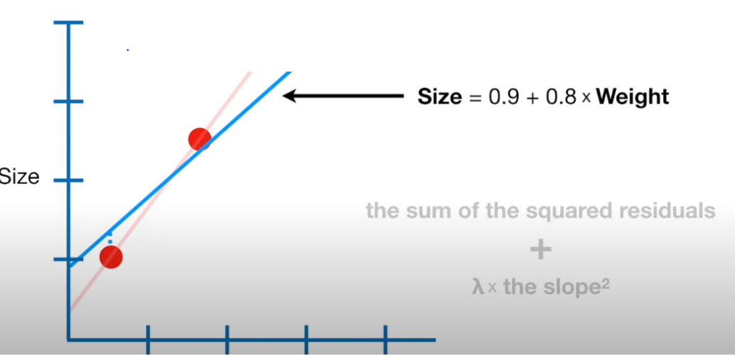
Plotting Line for RIDGE Regression Line

Slide 22
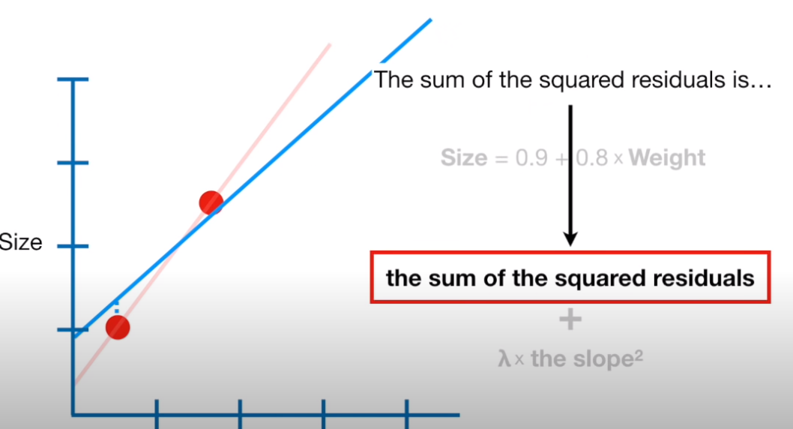
Assuming the error values for both the Data Point

Slide 23
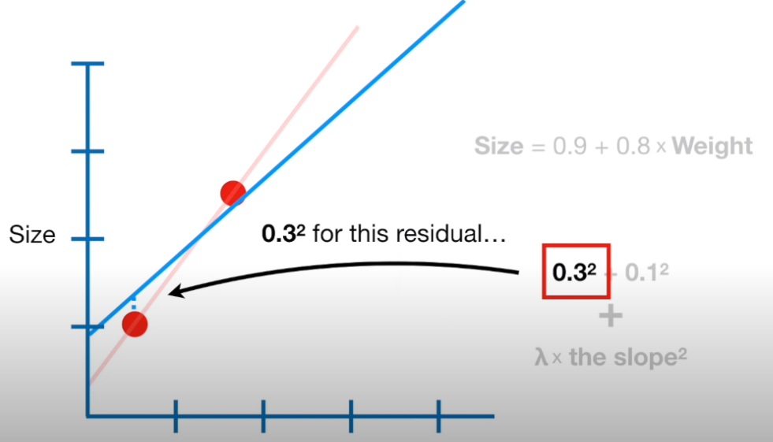

Slide 24
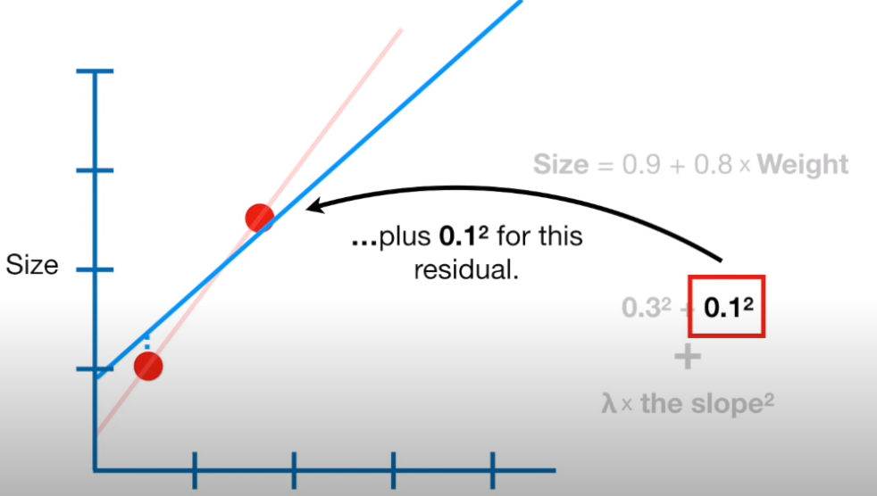

Slide 25
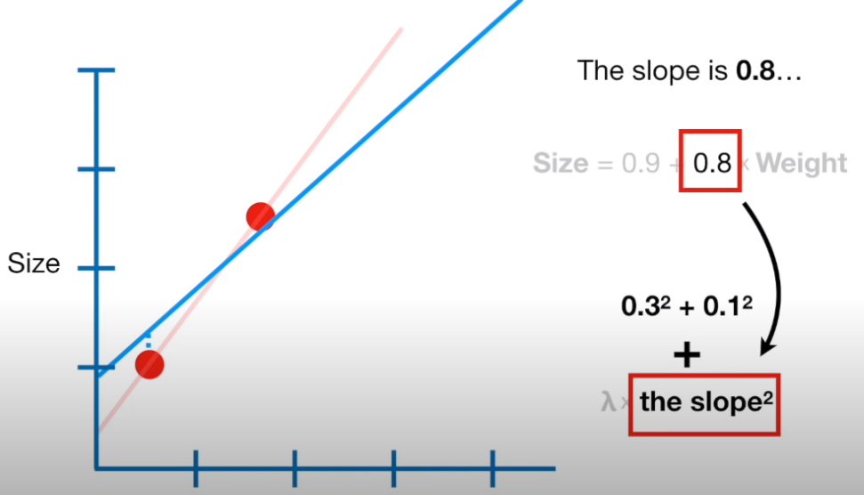

Slide 26
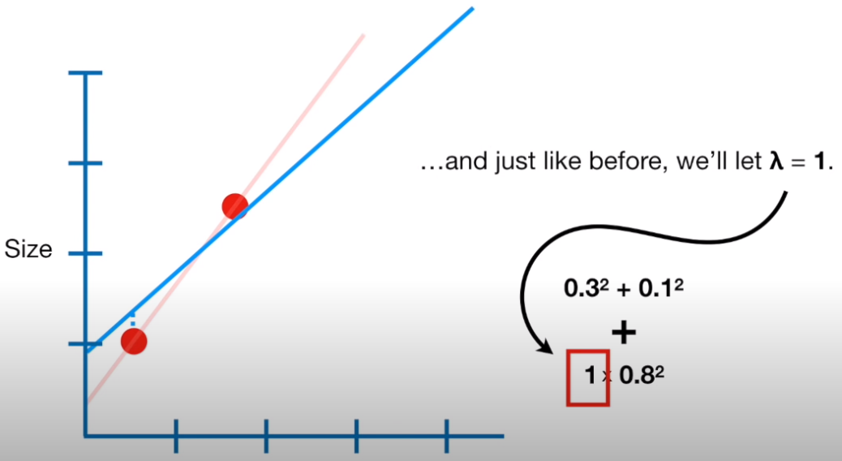

Slide 27
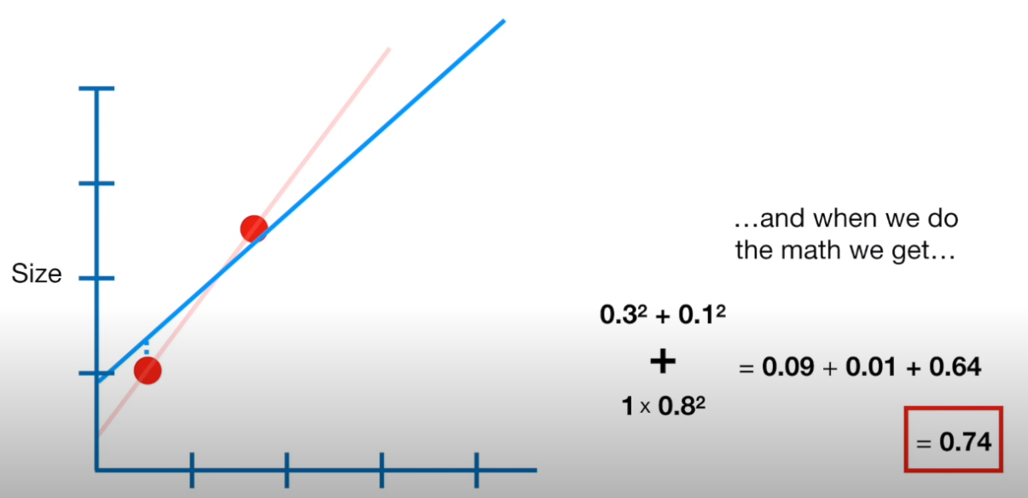
RSS + lambda * Squared values

Slide 28
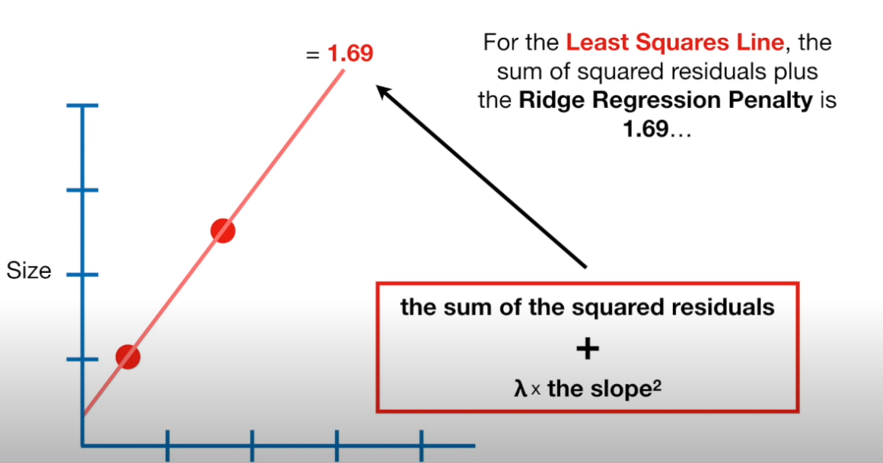

Slide 29
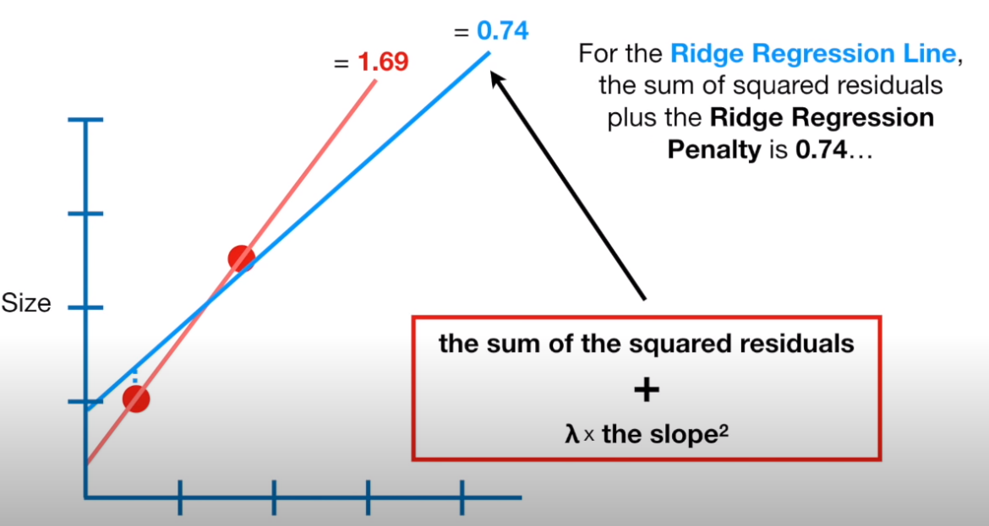

Slide 30
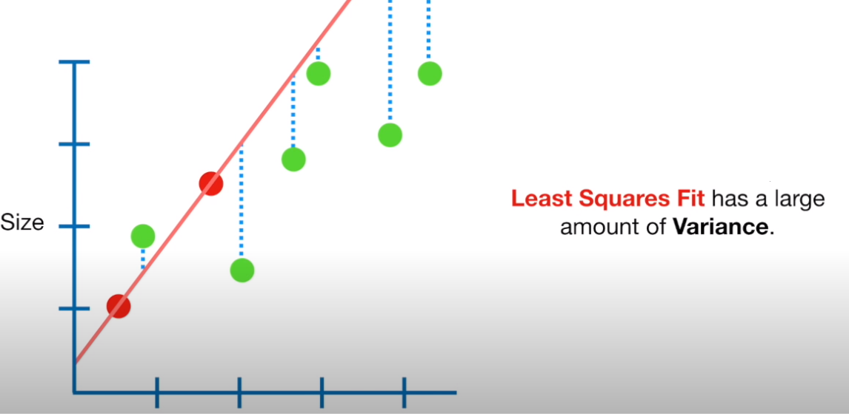

Slide 31
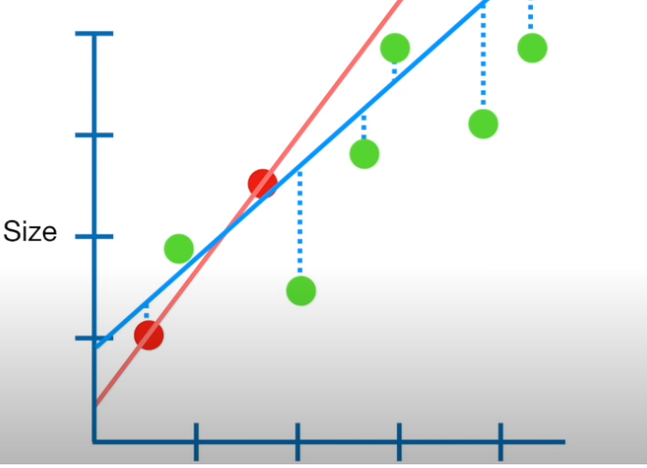
Ridge Regression fit has a Small amount of Variance

Slide 32
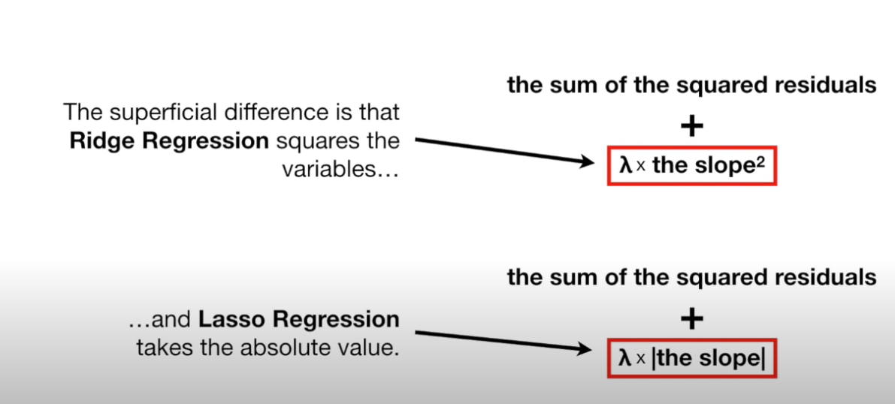

Slide 33
THANK YOU

